Slide 1
Lecture 2
Linear Regression
Sung Kim <hunkim+ml@gmail.com>
http://hunkim.github.io/ml/

Slide 2
Acknowledgement
Andrew Ng’s ML class
https://class.coursera.org/ml-003/lecture
http://www.holehouse.org/mlclass/ (note)
Convolutional Neural Networks for Visual Recognition.
http://cs231n.github.io/
Tensorflow
https://www.tensorflow.org
https://github.com/aymericdamien/TensorFlow-Examples

Slide 3
Predicting exam score: regression
x (hours) | y (score)
10 | 90
9 | 80
3 | 50
2 | 30

Slide 4
Regression (data)
x | y
1 | 1
2 | 2
3 | 3

Slide 5
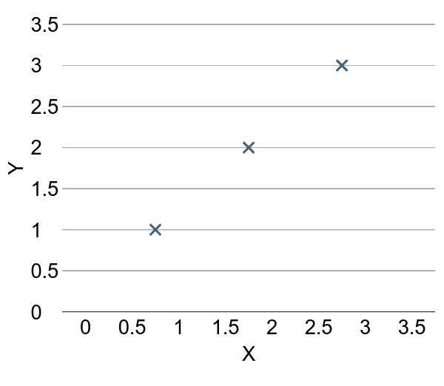
Regression (presentation)
x | Y
1 | 1
2 | 2
3 | 3

Slide 6
(Linear) Hypothesis

Slide 7
(Linear) Hypothesis

Slide 8

(Linear) Hypothesis

Slide 9
Which hypothesis is better?

Slide 10
Which hypothesis is better?

Slide 11

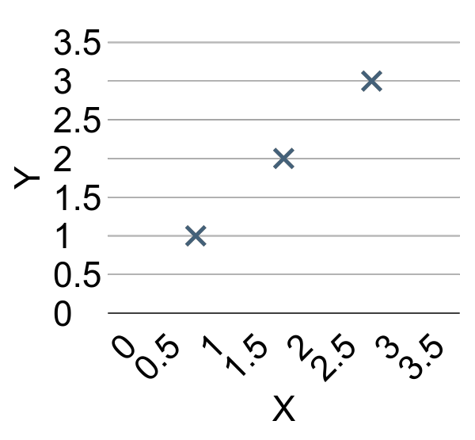
Cost function
How fit the line to our (training) data

Slide 12

Cost function
How fit the line to our (training) data

Slide 13

Cost function

Slide 14

Goal: Minimize cost

Slide 15
Lab 2
Linear Regression
Sung Kim <hunkim@gmail.com>

Slide 16

Next
How to minimize cost

